Slide 1

Functions in Python

Slide 2
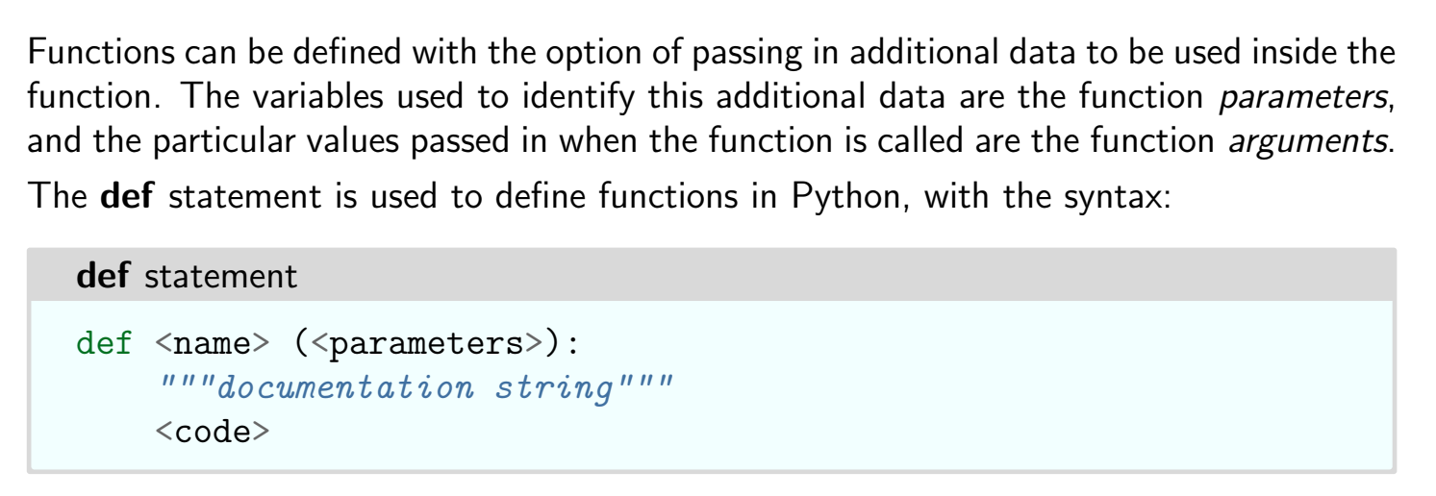
Function

Slide 3
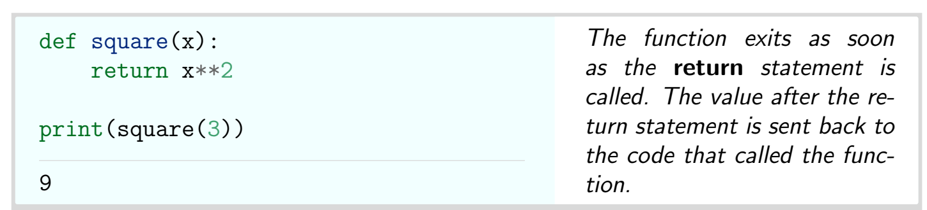
Example

Slide 4
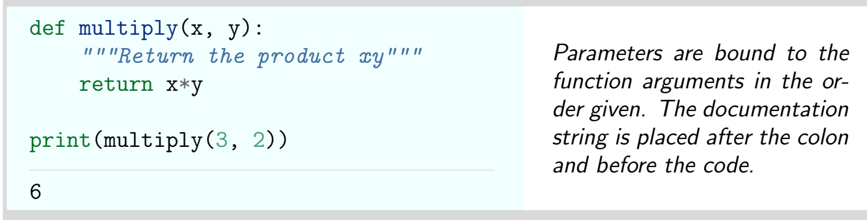
Example

Slide 5
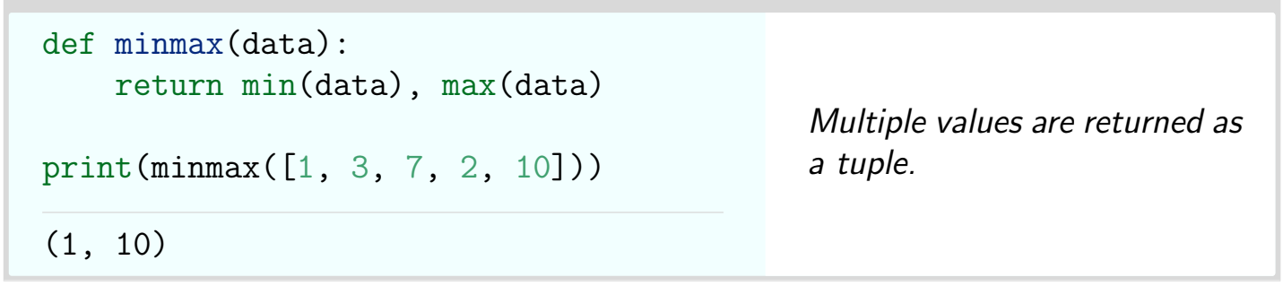
Example

Slide 6
Thank You

